Slide 1



DATA SCIENCE ACADEMY
CAPSTONE PROJECT
RIDE HAILING
INTERNET PACKAGE
GROUP 12
Yustinus Kunta Wibisana
Shelby Marsa Istiqomah
Wahyu Sejati Roso
Rizaldy Al Kautsar Utomo

Slide 2



Executive Summary of DSA -Ride Hailing Internet Package for Driver
Business Background
Proposed Solutions
Business Benefit
The growth of online ride-hailing business in Indonesia is potential market to get more data users for Telkomsel
Telkomsel launched a special combo data package for online ride-hailing drivers with IDR 75K for price
Competitor offered merely same package for “mitra driver” with competitive price (IDR 20K – 75K)
We propose 3 main cluster with different behaviour and usage, resulting in different package price :
Economic Customer = Lowest ARPU & data consumption, Usage primarily for Ojol apps.
Mid Spender = Medium ARPU & payload, highest voice mou & transaction
Data Addict = High data consumption & dominant video & social app usage.
Increase active data user
Increase revenue (ARPU) from customer
Problems Statements
Only 41.77% (547 K subscriber) takers from 1.2 Mio mitra driver who use Telkomsel number
How to identify takers from potential mitra driver
How much affordable price for combo package for mitra driver
Result
There are potential 55k new numbers of takers based on this algorithm. In total there are 406k potential package takers
44.2% taker rate, uplift +4% from previous data
Objective
GROUP 12
Yustinus Kunta Wibisana
Shelby Marsa Istiqomah
Wahyu Sejati Roso
Rizaldy Al Kautsar Utomo
By :
1
Build supervised model that can predict takers
2
Create segment of customer with clustering
3
Develop subsegment based on ARPU

Slide 3

CRISP-DM
RIDE-HAILING INTERNET PACKAGE
1
Business Understanding
4
Modelling
Understand objective and requirement from business perspective
Building the model for desired output
2
Data Understanding
5
Evaluation
Getting familiar with the data to form hypotheses
Assess the quality of the model based on requirement
3
Data Preparation
6
Deployment
Construct dataset from raw data
Put the result to work and achieve the goals

Slide 4
BUSINESS
UNDERSTANDING

Slide 5
Ride-Hailing is multi billion business in Indonesia, and the driver stand as partner which plays crucial role, represent 0.9% of Telkomsel Population
Gojek drivers as a partner contribute to IDR 8 Trillion annually (2018)
34% of them have monthly income of > IDR 3.5 million after joined as ride hailing driver, only 8% of them already have it before join as a partner
Serving
Active Ride-Hailing Drivers
Active Ride-Hailing Users
Driver to Consumer Ratio
1:11
1.48 Million
16.86 Million
Daily income of IDR 150-200k/day, communication expense can be a burden if Telco company don’t provide the best offering
*Telkomsel MSIGHT January 2020 Data
** Lembaga Demografi FEB UI (2018)

Slide 6
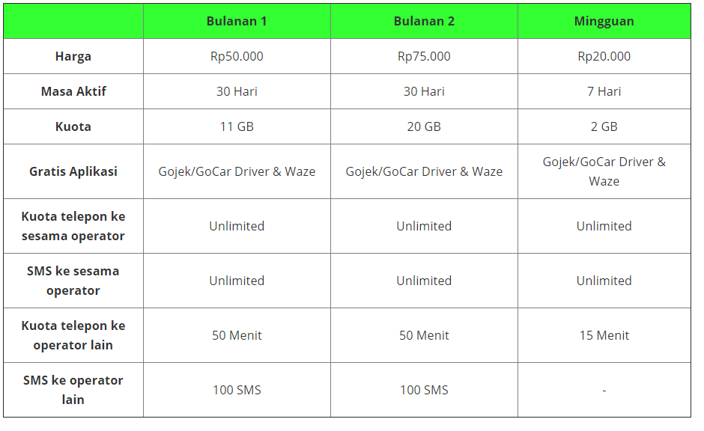
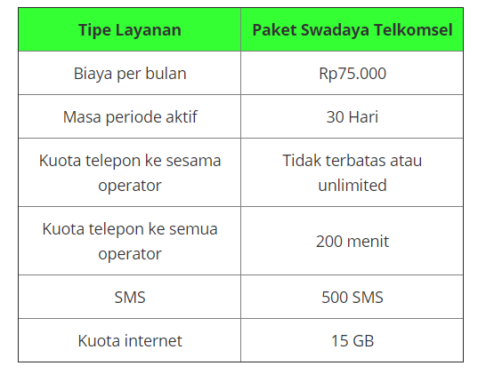
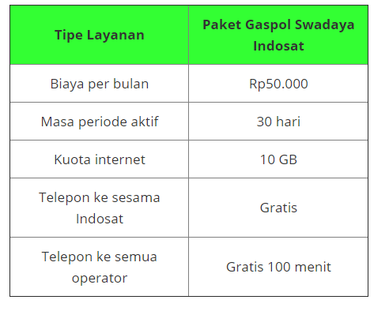
Telkomsel as connectivity provider stand as enabler to make the driver experience with ride-hailing app more seamless
XL
Telkomsel
Indosat
Price/GB
IDR 3750
Price/GB
IDR 5000
Price/GB
IDR 5000
Telkomsel has several competitor with more competitive price for ride-hailing driver package. We need to enhance value proposition to improve the takers of package

Slide 7







Understanding driver needs and usage of connectivity with data science can be the key to drive more takers in Ride-Hailing package
Driver Workflow
Internet Data Access
Balanced transport supply-demand
CORE APP
Service Excellence
Legacy Communication (SMS & Voice)
Connectivity
Productivity
Boost Economic Growth
SUPPORTING APP
Data Collection
Package Offering
A
Prediction of package takers
1
Assessing Driver’s need of connectivity based on historical data
2
Understand package takers behaviour
New opportunity of package pricing based on segment (cluster)
Data Science Modelling
B
Telkomsel’s Business Opportunity

Slide 8
… based on previous business problem, 3 objective and key result can be derived with data science process (classification & clustering)
Problem Statement
Objective
Telkomsel already have ride-hailing package for drivers, priced at IDR 75k/month.
The package are targeted for whitelisted MSISDN, as October’19 there are 1.31 mio of whitelist with 547k takers (41.7%)
1
Build supervised model that can predict takers
2
Create segment of customer with clustering
3
Develop subsegment based on ARPU
Key Result
1
Achieve 80% Area Under the Curve (AUC) and 70% F1-Score
2
Reach Silhouette Score of >0.6 to determine cluster size
3
Achieve projected revenue increase of xxx by uplift and package offering

Slide 9
… to achieve the result, expected timeline is 2 months of CRISP-DM complete cycle
W2 Feb | W3 Feb | W4 Feb | W1 Mar | W2 Mar | W3 Mar | W4 Mar | W1 Apr
Business Understanding
Data Understanding
Data Preparation
Develop Model MVP
Evaluation & Iteration
Delivery & Deployment

Slide 10
DATA
UNDERSTANDING

Slide 11
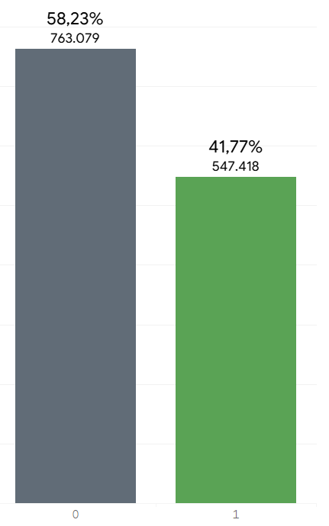
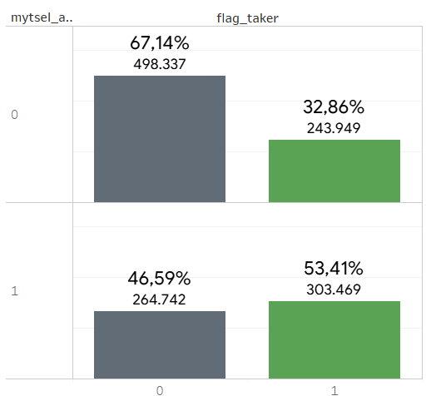
547k subscriber from whitelist took the package, and users with active MyTelkomsel app have higher rate of takers
Overall Takers
MyTsel Flag
41.77% subscriber from cleaned dataset, take the package in previous month
Users with activity in MyTelkomsel, have higher rate of takers (53.41%)

Slide 12
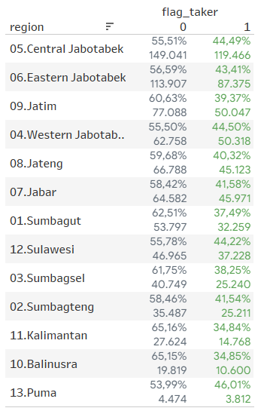
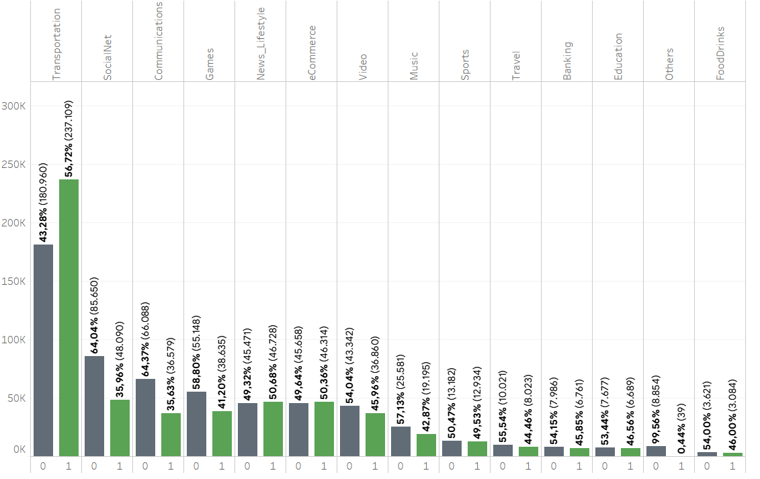
Region and most frequent app category of users also have distinguish rate of takers
Region
First Rank Category
Users from Jabotabek contribute to highest number of users and high takers rate (>43%)
Users with high activity on Transportation Apps have the highest rate of takers with 56.72%

Slide 13
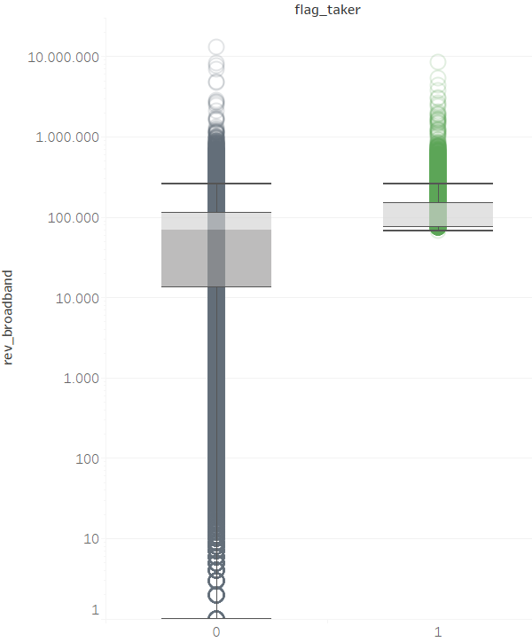
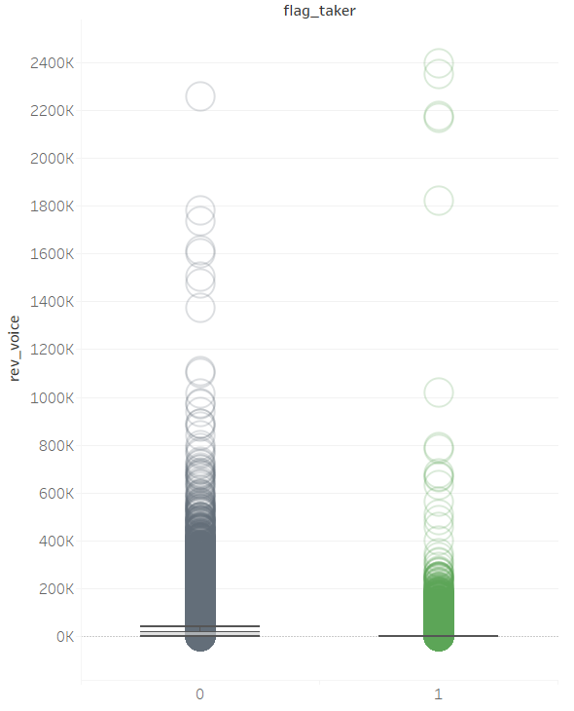
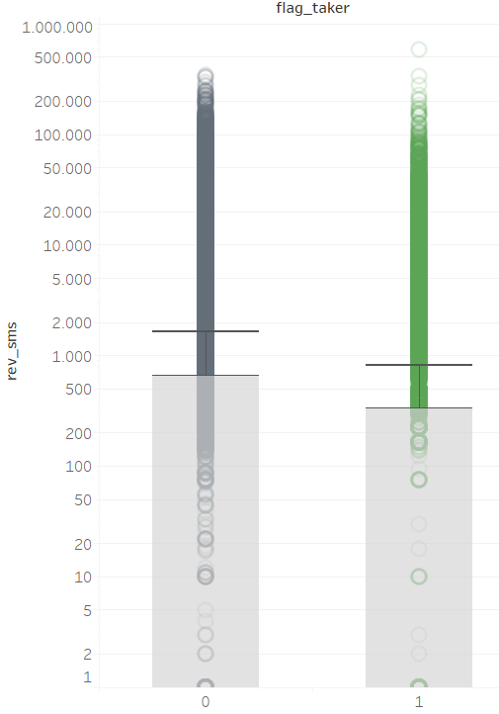
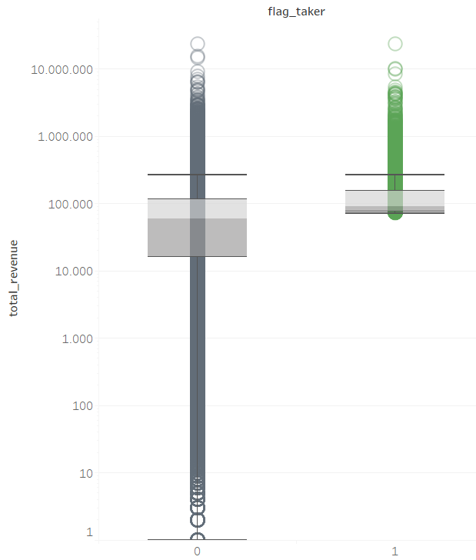
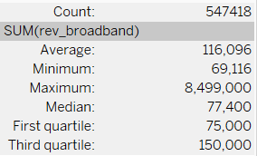
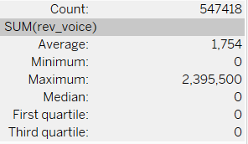
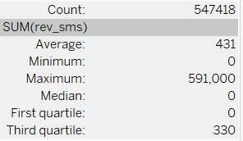
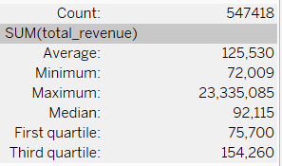
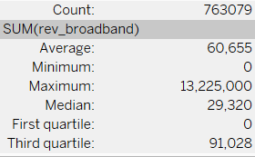
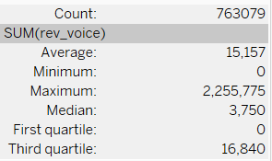
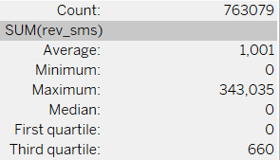
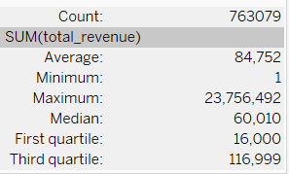
Revenue Analysis – Package Taker have much higher revenue on the data revenue but fall short on voice revenue and sms revenue
Revenue Data
Revenue Voice
Revenue SMS
Total
Avg
-56.9%
Avg
-88.4%
Avg +91%
Avg +48.1%
Median +163%
Median +53.4%
Taker
Non-Taker

Slide 14
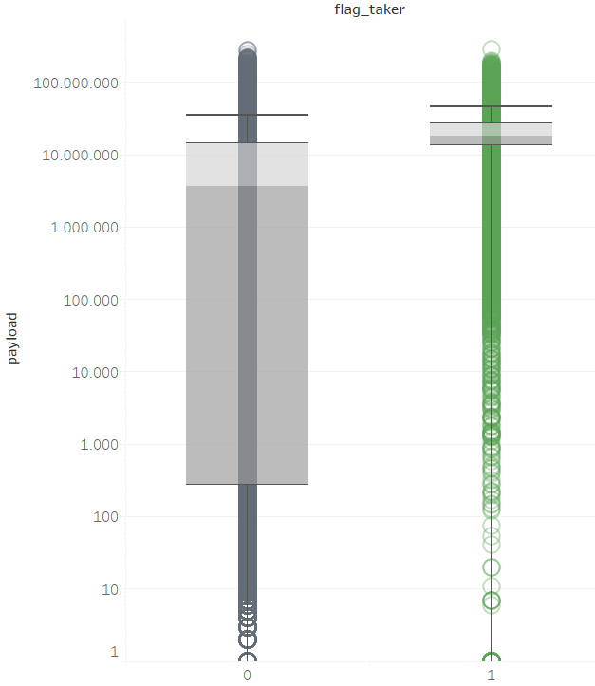
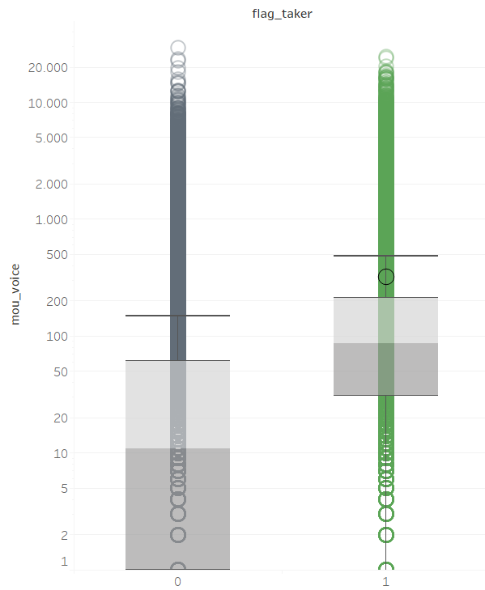
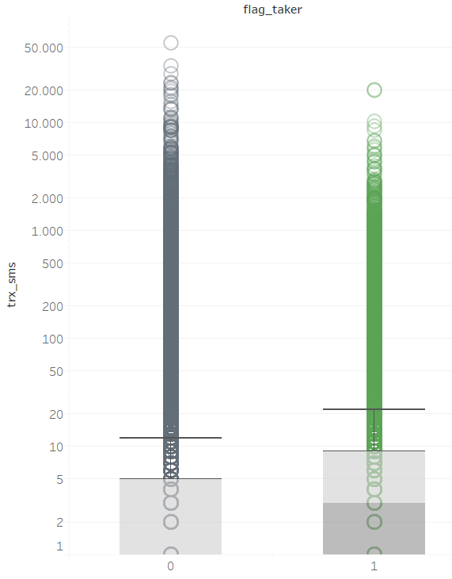
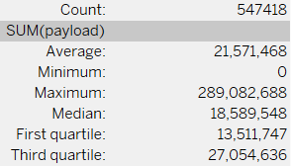
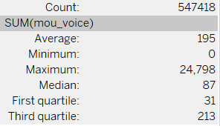
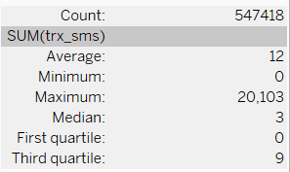
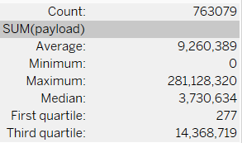
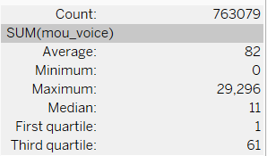
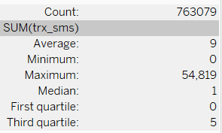
Usage Analysis – Package Taker consistently have heavier usage on data payload, minutes of voice and number of sms
Payload (Data)
Minutes (Voice)
SMS (Trx)
Avg +132%
Avg +137%
Avg +33%
Median +398%
Median +690%
Median +200%
Taker
Non-Taker

Slide 15
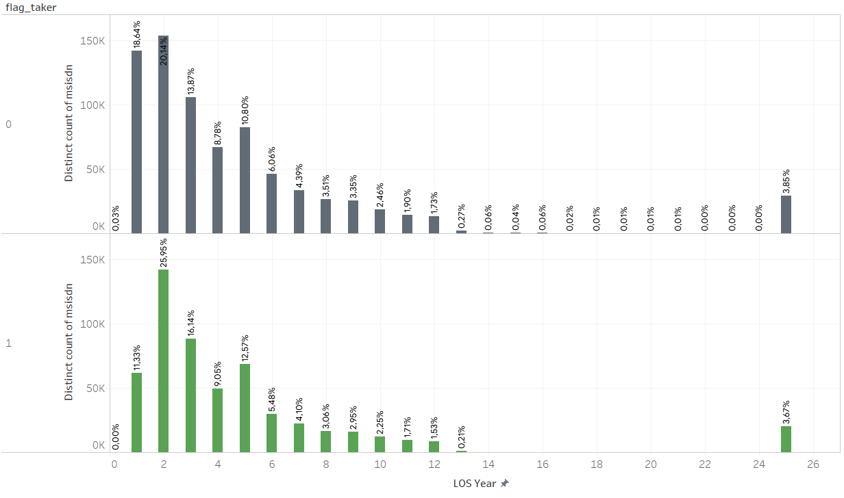
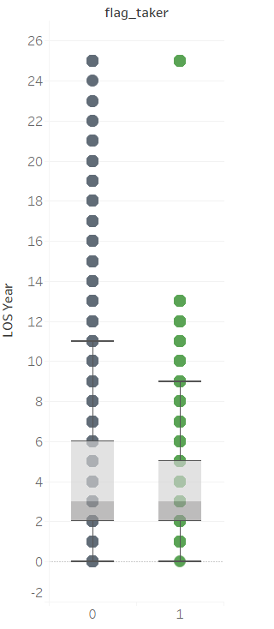
Length of Stay – Package Taker relatively have skew to younger stay in Telkomsel as the 3rd Quartile is 5 years
1st Quartile
2
Median
3
3rd Quartile
6
1st Quartile
2
Median
3
3rd Quartile
5

Slide 16
DATA
PREPARATION

Slide 17
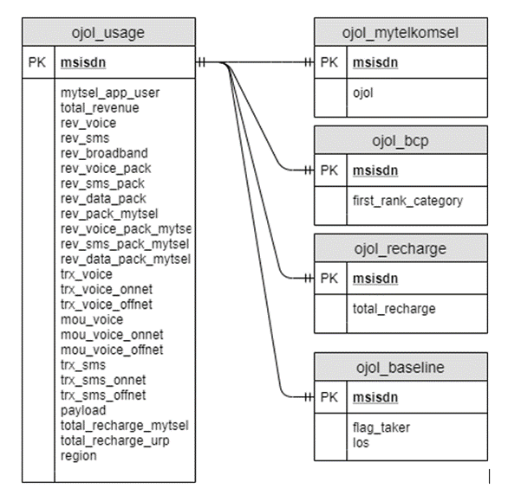
Data Pipeline and Integration – Encoding, Ratio, Flag, Binning are used for feature extraction
Data Source:
MySQL
5 Tables:
ojol_mytelkomsel
ojol_bcp
ojol_recharge
ojol_baseline
ojol_usage
Table Integration:
ojol_joined
Data Cleaning:
ojol_joined_cleaned
Remove msisdn with zero usage, achieve 1.31 million MSISDN of cleaned dataset

Slide 18
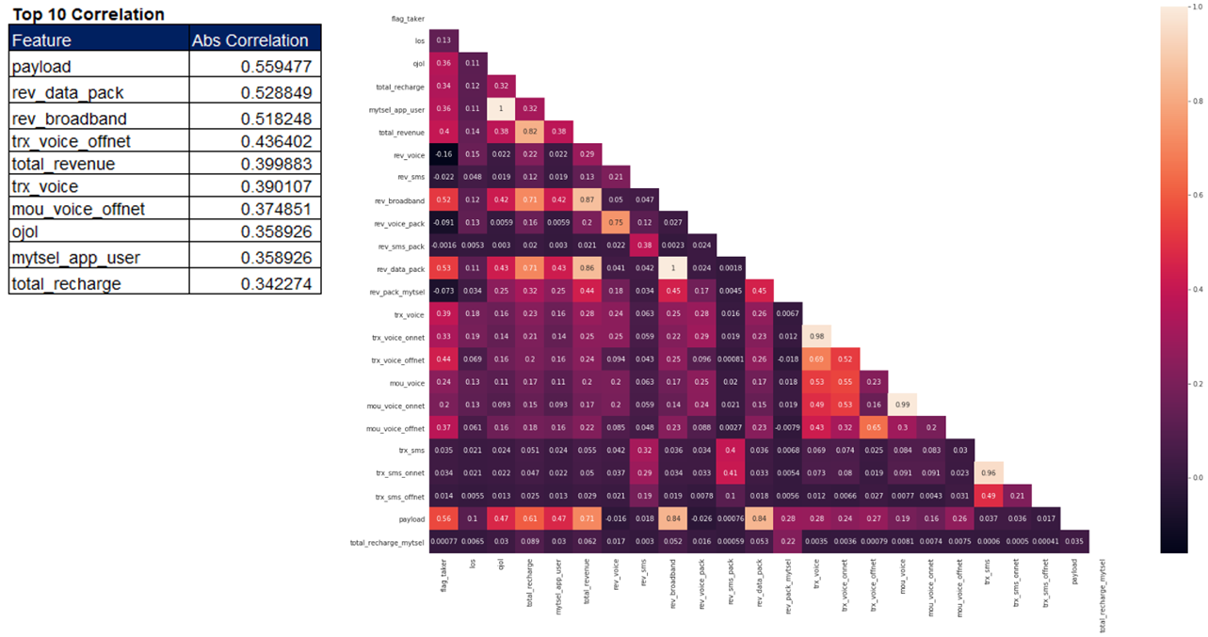
Understanding the Correlation
Based on the exploration on correlation, variable from data usage such as payload, revenue data package, and revenue broadband have the highest absolute correlation to flag

Slide 19
Feature Extraction and Engineering – Encoding, Ratio, Flag, Binning are used for feature extraction
One Hot Encoding
Missing Value Handling
Binning and Log Value
One Hot Encoding on columns first_rank_category and region
Impute missing value on ‘first_rank_category’ with string ‘Missing Value’
Add mou/trx ratio
Add ratio for each service type revenue / total revenue
Add ratio for each service type trx * los
Add revenue/recharge ratio
Add recharge - revenue ratio
Drop columns that only contain 0 values
Flag
Ratio
Total Features after Feature Engineering:
134
Add flag whether customer have voice, sms, data transaction
Add log revenue due to large skewness on revenue data distribution
Binning revenue on interval (250k,500k,1M,2.5M,5M,10M,15M,20M)

Slide 20
MODELLING

Slide 21
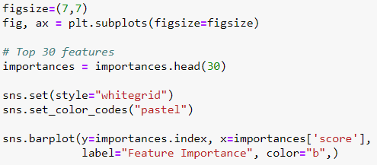
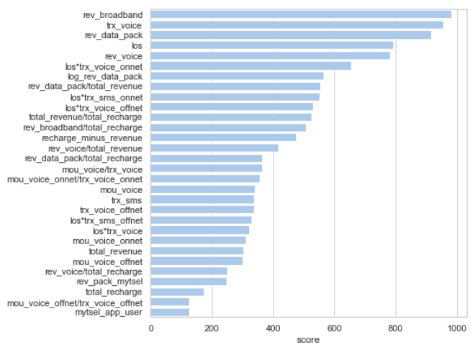
30 top feature ingested into the model, feature selection conducted using XGBoost algorithm
Revenue of data usage (rev_broadband & rev_data_pack) managed to get into top 3
Feature that created from feature engineering managed to have high score

Slide 22









To ensure we get the best performing model, we train the model in several iteration. Iteration 3 have best overall performance (f1 score) compared to previous iterations.
1. Raw feature
(26 Features)
2. Feature engineering:
(134 Features)
3. Feature engineering &
feature selection
(30 Features)
Logistic Regression
Decision Tree
Random Forest
Overall F1 Score = 85.8
Overall F1 Score = 85.7
Overall F1 Score = 86

Slide 23
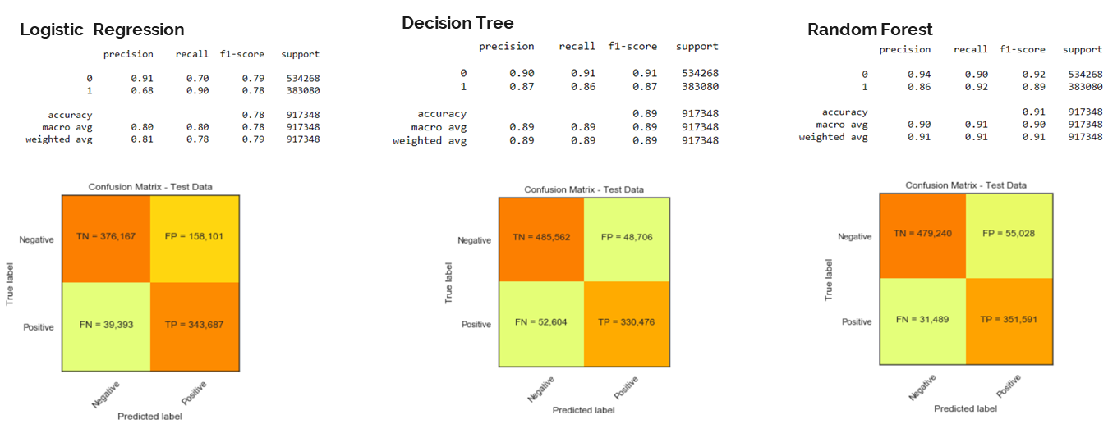
For 1st Objective (Classification), Random Forest achieved highest score, compared to Logistic Regression and Decision Tree
F1 Score= 79%
F1 Score= 89%
F1 Score= 91%
All algorithm managed to achieve key result of F1-Score above 70%, we decided to went with Random Forest that managed to have high precision and recall resulting with high F1-Score (91%)

Slide 24
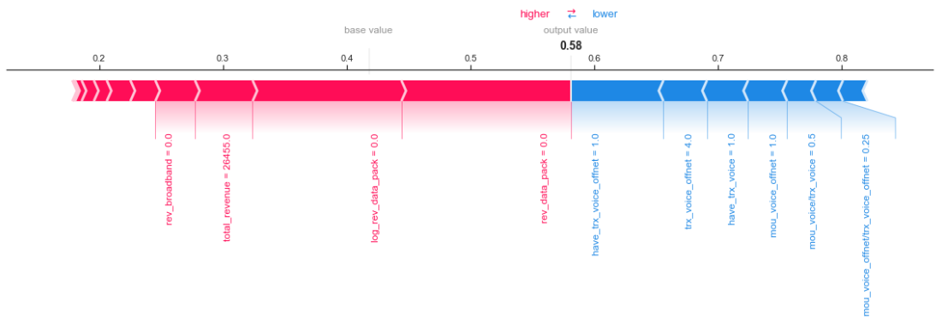
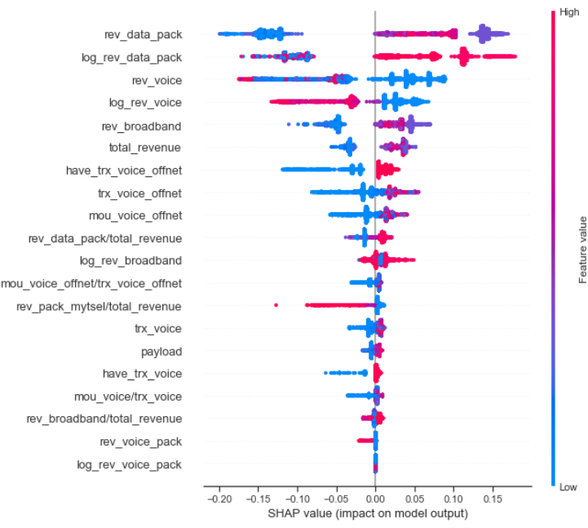
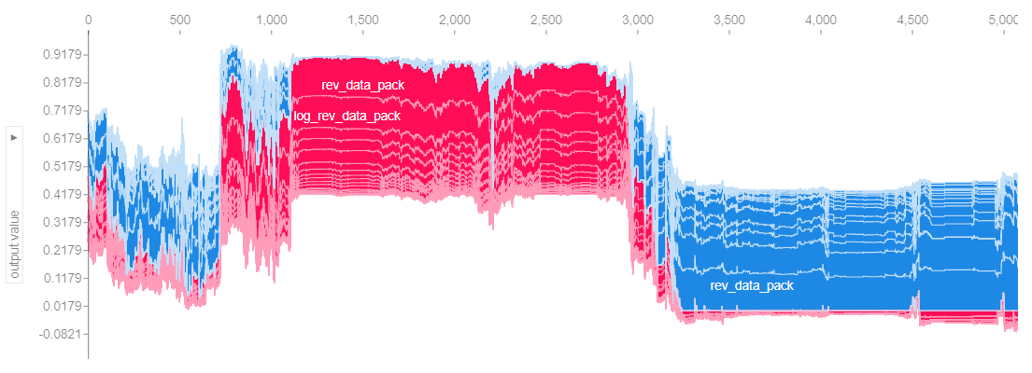
SHAP Value also determined that data_package is the most important feature, followed by voice

Slide 25
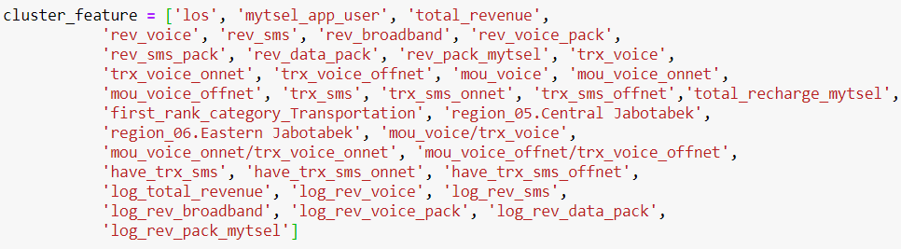
Output from 1st Objective (Classification) will be used for determining cluster and final deliverable for package offering
Input
Output
Predicted Takers from Classification (55k MSISDN)
36 Features
N-number of Cluster (determined from optimum number)
Output from classification is used for clustering, as a foundation to build potential package offering based on segmentation
Sub-Cluster based on price segment (ARPU)
Process
Potential Package Offering based on best sub-cluster and respective consumer segment
Determining Optimal # of Cluster
(Elbow Method & Silhouette Score)
3D visualization of cluster
Package offering based on sub-cluster is expected as the final output, and with cluster analysis each MSISDN is segmented into correct package which match the usage behaviour
Number of cluster is determined with silhouette score & elbow method, also visualization is needed to make sure cluster grouping is not overfit and consistent across the features

Slide 26
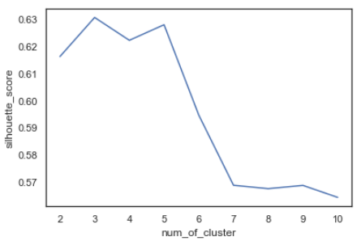
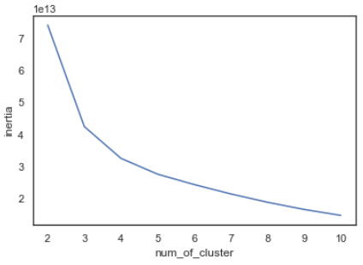
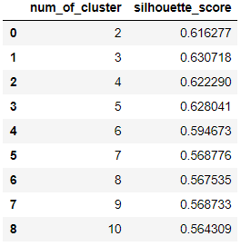
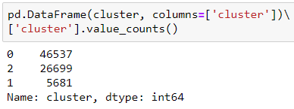
For 2nd Objective (Clustering), silhouette score is used to determine number of cluster. The optimal number of cluster is 3
Determining number of cluster
Total MSISDN in each cluster

Slide 27
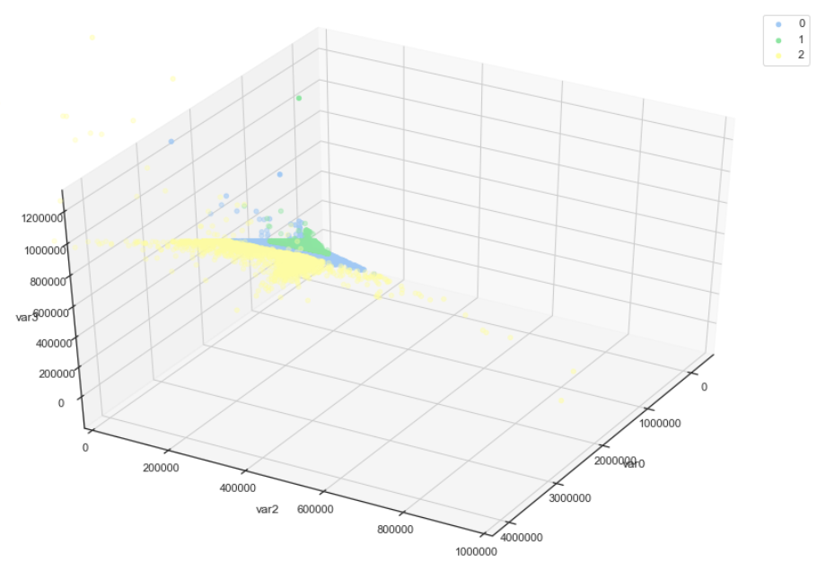
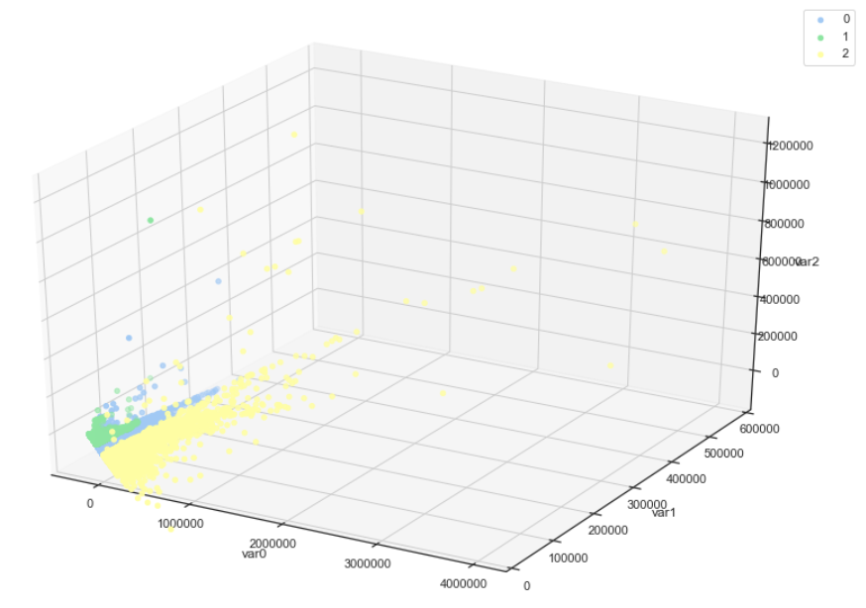
For 2nd Objective (Clustering), using PCA Analysis and 3D Viz, cluster looks have consistent grouping
Cluster seems have consistent grouping (not underfit/overfit) based on 3D visualization.
Cluster 0 have the largest number of MSISDN (46k), followed by cluster 2 (26k) and cluster 1 (3k)
3D Cluster Visualization using PCA Analysis
Feature 1, 2 & 3
Feature 1, 2 & 4

Slide 28
EVALUATION

Slide 29
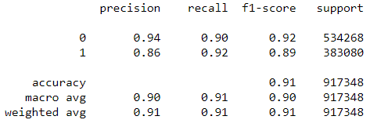
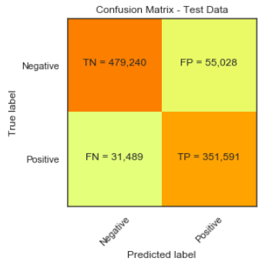
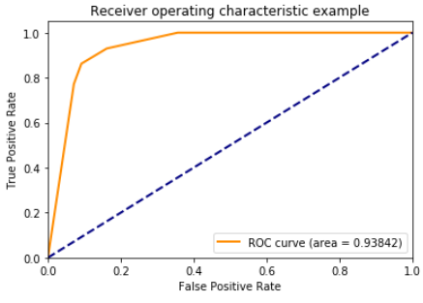
Random Forest successfully meet the 1st objective for classification with 93.8% of AUC and 91% of F1-Score
There are potential 55k new numbers of takers based on this algorithm. In total there are 406k potential package takers.
44.2% taker rate, uplift +4% from previous data

Slide 30
For the 2nd Objective, there are 3 main cluster with different behaviour and usage, resulting in different package price
Economic Customer
46.5k subs
IDR 100k
11 GB
Mid Spender
26.7k subs
IDR 155k
25 GB
Data Addict
5.68k subs
IDR 275k
51 GB
ARPU
ARPU Data
Payload
Voice mou
Voice trx
Video &
Social Media
Transportation Apps
Description
Economic Customer
100.5k 92k 11 GB 112 Min 77 8.7% 52.8%
Lowest ARPU & data consumption.
Usage primarily for Ojol apps.
Mid Spender
155k 144k 25 GB 144 Min 92 19% 37.7%
Medium ARPU & payload, highest voice mou & transaction
Data Addict
275k 253k 51 GB 139 Min 84 43.7% 18.2%
High data consumption & dominant video & social app usage.

Slide 31
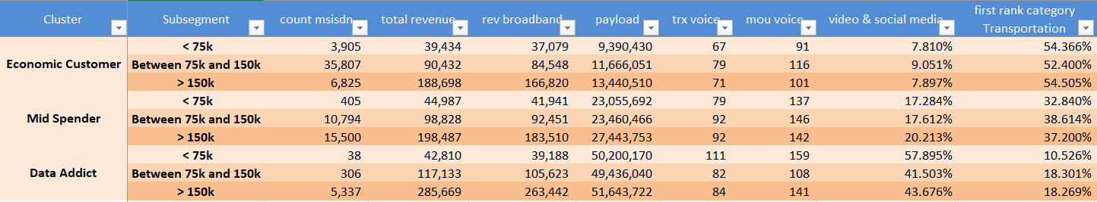
For the 3rd Objective, main cluster derived into each 3 sub-cluster each, resulting in 9 different sub-cluster
Lower ARPU (< IDR 75k)
Middle ARPU (IDR 75k – IDR 150k)
Top ARPU (>IDR 150k)
Economic
Customer
3.9k subs
IDR 39k
9 GB
35.8k subs
IDR 90k
11 GB
6.8k subs
IDR 188k
13 GB
Mid Spender
405 subs
IDR 45k
23 GB
10.8k subs
IDR 99k
23 GB
15.5k subs
IDR 198k
27 GB
Data Addict
38 subs
IDR 42k
50 GB
306 subs
IDR 117k
49 GB
5.3k subs
IDR 285k
51 GB

Slide 32
DEPLOYMENT

Slide 33
